Slide 1


Amazon Sales Analysis

Slide 2
INTRODUCTION +
PROBLEM STATEMENT
Amazon’s vast marketplace offers a wealth of data that can unlock significant growth opportunities.
Sales management today is the most important function in a commercial and business enterprise.
This sales analysis explores the patterns and factors to increase profit and decrease the cost spend on products.

Slide 3

Programming Language: PYTHON
Software: TABLEAU PUBLIC
Library Used: NUMPY, PANDAS, MATPLOT LIB, SEABORN

Slide 4


Glance Over the Data
12 Items
76 Countries
100 Records
2 Channels
7 Regions
4 Priorities
C/L/M/H
2010 | 2011 | 2012 | 2013 | 2014 | 2015 | 2016 | 2017

Slide 5

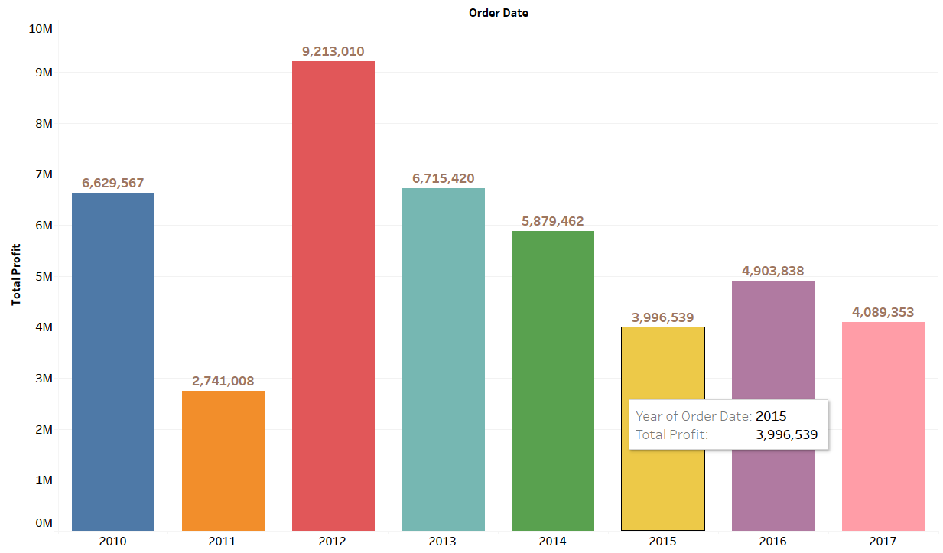
Yearly Analysis
According to given data,
2012 is the year with maximum profit sales around 9 million
2011 is the year with minimum profit sales around 3 million
2010 and 2013 also showed average sales around 6 to 7 million.

Slide 6
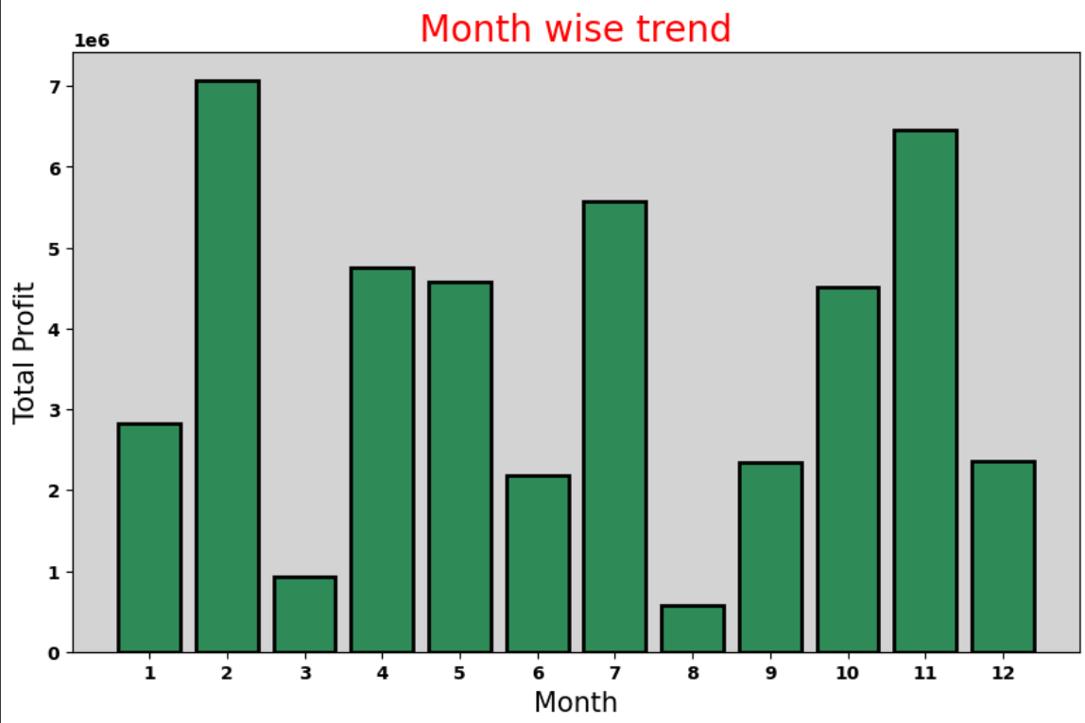
Monthly Analysis
According to given data, if we aggregate the profit of each month.
FEBRUARY is the month with maximum profit sales around 7 million
AUGUST is the month with minimum profit sales around 1 million
NOVEMBER and JULY also showed average sales around 5 to 6 million.

Slide 7
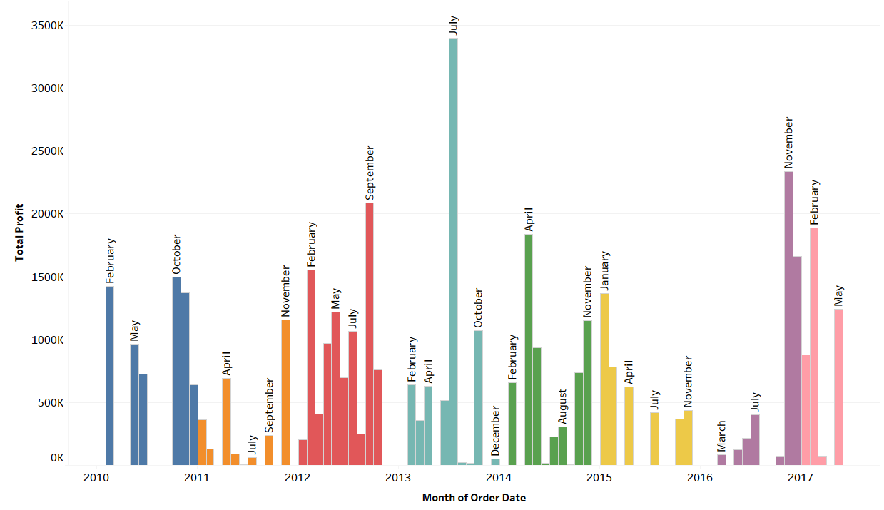
Yearly-Month Analysis
According to given data,
JULY 2013 is with maximum profit sales
There are also many times when sales gave barely the profit of 1K.

Slide 8
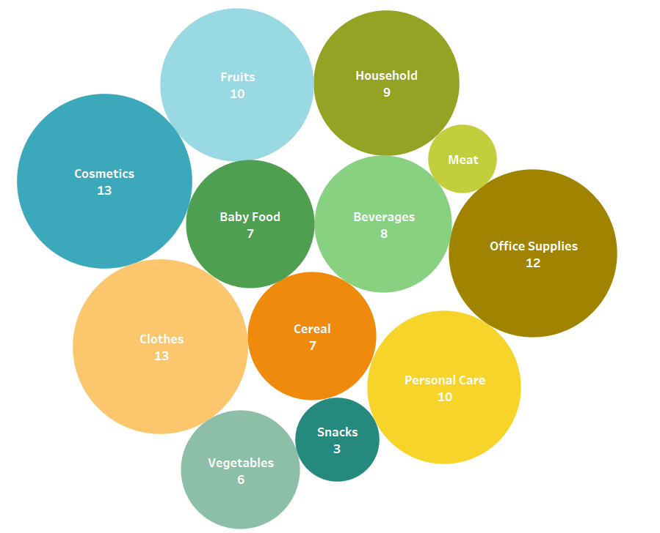
Product Items Demand
Most Demanded Items are COSMETICS and
CLOTHES.
Least Demanded Item are MEAT and SNACKS
While Office supplies and Fruits are average demanded items

Slide 9
Region Wise Analysis

Slide 10
Channel Wise Profit
Here we can see the offline channel has more demand and potential than online channel
But online channel is growing enough to compete with offline channel.

Slide 11
CONCLUSION
Seasons are influencing the matter of sales, like early winters are overpowering sales every year.
Seasons and sales channel together form decision for better sales.
Sub-Saharan Africa is greatest customer with both channels.
February month is promising for sales purpose.
Selling items at little less cost at particularly these situations can makes more profit and increase in sales

Slide 12
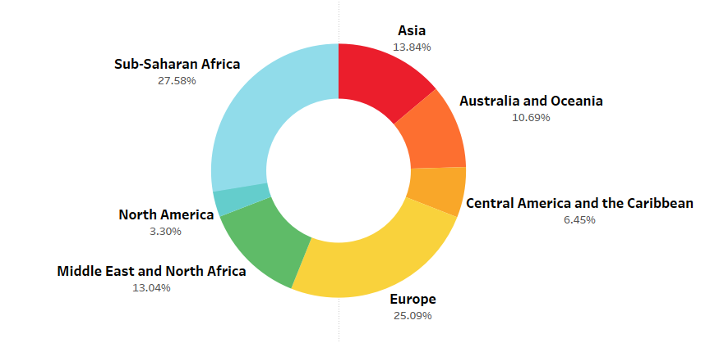
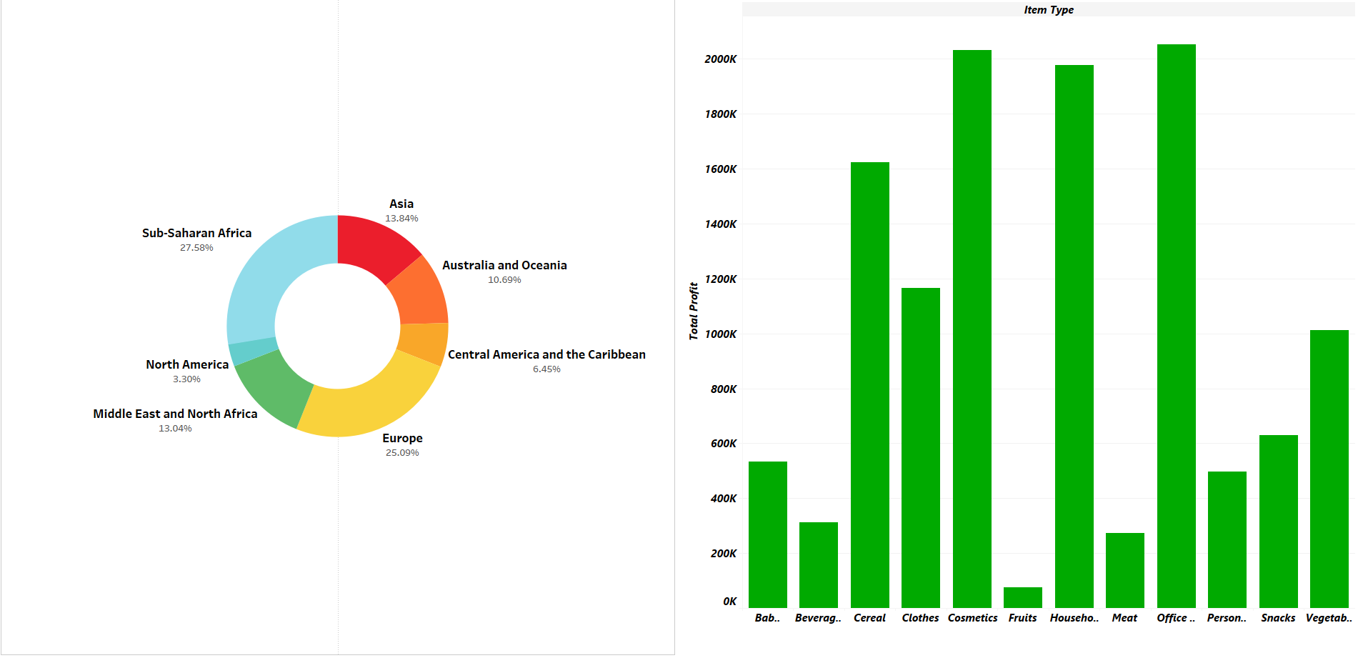
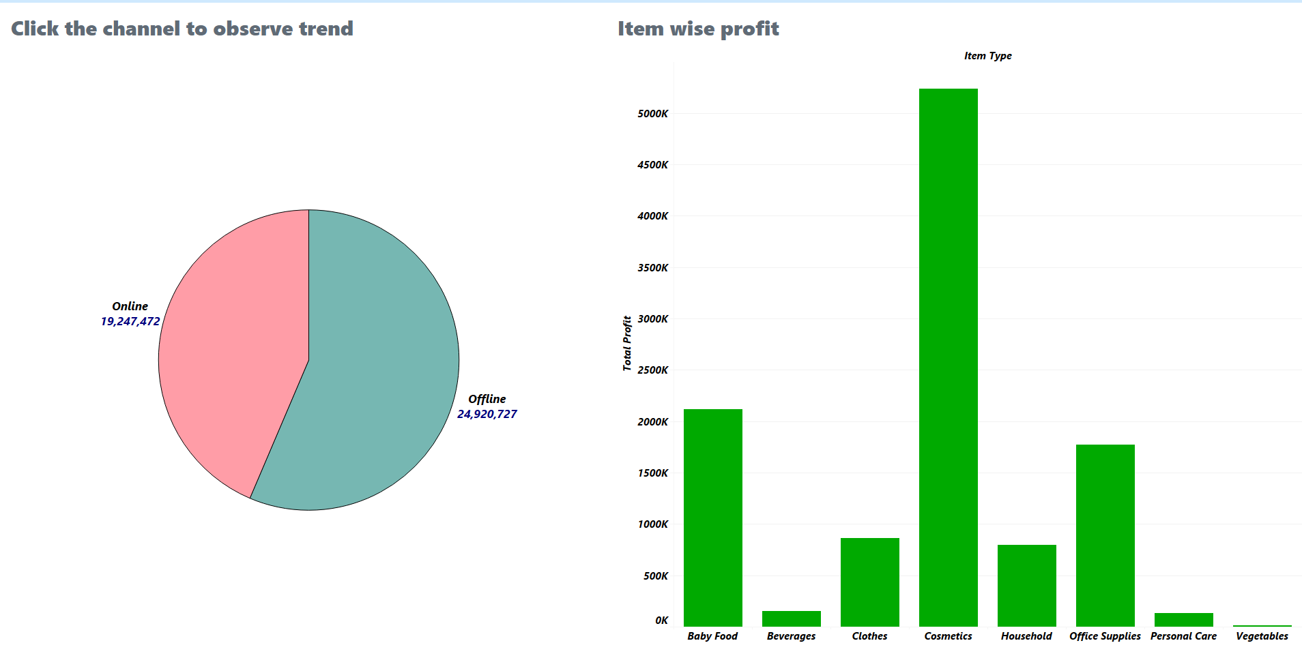
Average Profit
Offline
56%
Average Profit
Online
44%
Mean of Revenue
$1373487
Mean of Cost
$931805

Slide 13


THANK YOU

